Slide 1
How to Use this Presentation:
Double-check each slide carefully to be sure that all points are applicable to your plans.
Copy and paste the slides into your open enrollment presentation.
To increase your enrollment rate, we recommend that you present these slides after you discuss your medical, vision and dental plans.
If a slide has a video on it, simply click the video to open it in your browser.

Slide 2
Individual Coverage
Health Reimbursement Account

Slide 3
What is an ICHRA?

Slide 4
Individual Coverage Health Reimbursement Account
With an ICHRA plan, your company has set aside a specific amount into an account for you to use on a healthcare plan - at no cost to you.
Instead of being limited to 1 or 2 group plans, you (and your co-workers) have the flexibility to choose any healthcare plan you want from the available options in your state. The ICHRA cannot be used to reimburse premiums for an employer-sponsored group health plan.

Slide 5
Individual Coverage Health Reimbursement Account
How much you can contribute:
What you can use it for:
Please fill in this section
Please fill in this section with eligible expenses

Slide 6
Individual Coverage Health Reimbursement Account
How it Works:
Use the Marketplace to chose the health insurance plan you want
Use your Ameriflex card to pay for the individual insurance premiums (or pay out of pocket and get reimbursed)

Slide 7
Individual Coverage Health Reimbursement Account
Pay your individual insurance premiums each month
If you have an Ameriflex Card, then it is as easy as swiping the card and then submitting paperwork showing proof of coverage. If you are paying for expenses out of pocket, then you will simply submit a claim form & proof of expense for reimbursement.
How you pay is dependent on what the insurance company will accept, but possibilities include:
Paying monthly via phone, online, or through a paper bill
Autopay
Syncing your personal bank account, and submitting proper documentation to Ameriflex for reimbursement

Slide 8
Individual Coverage Health Reimbursement Account
Types of proof
For Premiums this can include just about any type of official report showing:
Company providing the insurance
Person covered
Timeframe of coverage and,
Cost
Types of documentation for medical expenses can include:
Itemized receipts
An Explanation of Benefits (EOB)

Slide 9
Individual Coverage Health Reimbursement Account
Important notes:
The funds are made available to you at the beginning of the defined plan year.
Since the ICHRA is employer funded, you as the employee will be required to submit documentation for an expense to identify the expense was allowed and within the employer’s parameters.
If you want to purchase an individual health insurance plan that costs more than what the ICHRA reimburses, you can have the difference deducted from your paycheck, pre-tax, through a Premium Only Plan (POP).
Short - term, limited - duration insurance (STLDI) premiums do not qualify.
If you qualify for and choose to use premium tax credits, you may not also use your ICHRA funds.

Slide 10
Individual Coverage Health Reimbursement Account
Frequently Asked Questions
Who pays for the insurance each month? You do. Your company is giving you money in an account to help cover the cost of healthcare insurance. You will pay for the insurance premium monthly either with the Ameriflex card or out of pocket and then be reimbursed from the account.
What if my monthly premium is higher than what my company is offering in the ICHRA? If you choose a plan that costs more than is being offered in your ICHRA plan, you can pay your monthly premium and then simply submit your claim and be reimbursed for the set amount in the ICHRA. Also, depending on your company’s plan you may have the option to set up a special account that you can use to help you pay the rest of your premium with tax free dollars.
How do I submit a claim for out of pocket expenses? Log onto your account at myameriflex.com and select “file a claim”
I tried to use my Ameriflex debit card to pay my premium and it was denied. This is most likely because the amount in the account is not sufficient to cover the premium. If this happens to you, you can pay for your premium out of pocket and submit a claim with Ameriflex to get reimbursed. Typical reimbursement time is 7-10 days.

Slide 11
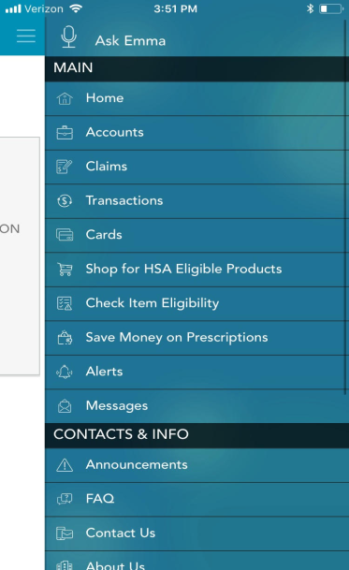
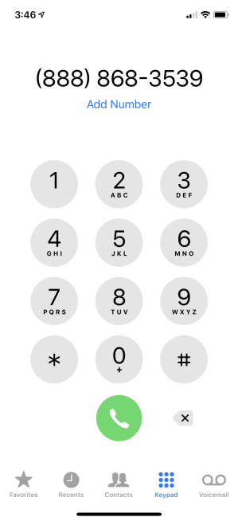
Ameriflex Support
Download the Mobile App
Call Us at
888.868.3539
Visit
www.myameriflex.com

Slide 12
Questions?

